Slide 1

7.Neural Computation
Committee Machines Lecture 7
2005 Ari Visa

Slide 2
Agenda
Some historical notes
Some theory
Committee Machines
Conclusions

Slide 3
7.1Some Historical Notes
Boosting by filtering: Schapire 1990
AdaBoost:(Schapire, Freund: A decision-theoretic generalization of on-line learning and an application to boosting, 1995)
Bagging: (Leo Breiman: Bagging Predictors 1996)
General arching: Leo Breiman: Arcing Classifiers, 1998)
Kittler, Hatef, Duin, On Combining Classifiers, 1998

Slide 4
7.1Some Theory
The principle of divide and conquer: a complex computational task is solved by dividing it into a number of computationally simple tasks and then combining the solutions to the tasks.
Committee machine = In supervised learning, computational simplicity is achieved by distributing the learning task among a number of experts, which in turn divides the input space into a set of subspaces. The combination of experts is said to constitute a
committee machine.
.

Slide 5
7.1Some Theory
Modularity (Osherson & al 1990): A neural network is said to be modular if the computation performed by the network can be decomposed into two or more modules that operate on distinct inputs without communicating with each other. The outputs of the modules are mediated by an integrating unit that is not permitted to feed information back to the modules.
In particular , the integrating unit both decides how the outputs of the modules should be combined to form the final output of the system, and decides which modules should learn which training pattern.

Slide 6
7.1Some Theory
Committee machines are universal approximators
a) Static structures: the responses of several experts are combined by means of a mechanism that does not involve the input signal
Ensemble averaging: outputs are linearly combined
Boosting: a weak learning algorithm is converted into one that achieves arbitarily high accuracy

Slide 7
7.1Some Theory
b) Dynamic structures: the input signal is directly involved in actuating the mechanism that integrates the outputs of the individual experts into an overall output.
- Mixture of experts: the responses of the experts are nonlinearly combined by means of a single gating network.
- Hierarchical mixture of experts: the responses of the experts are nonlinearly combined by means of several gating network arranged in a hierarchical fashion.

Slide 8
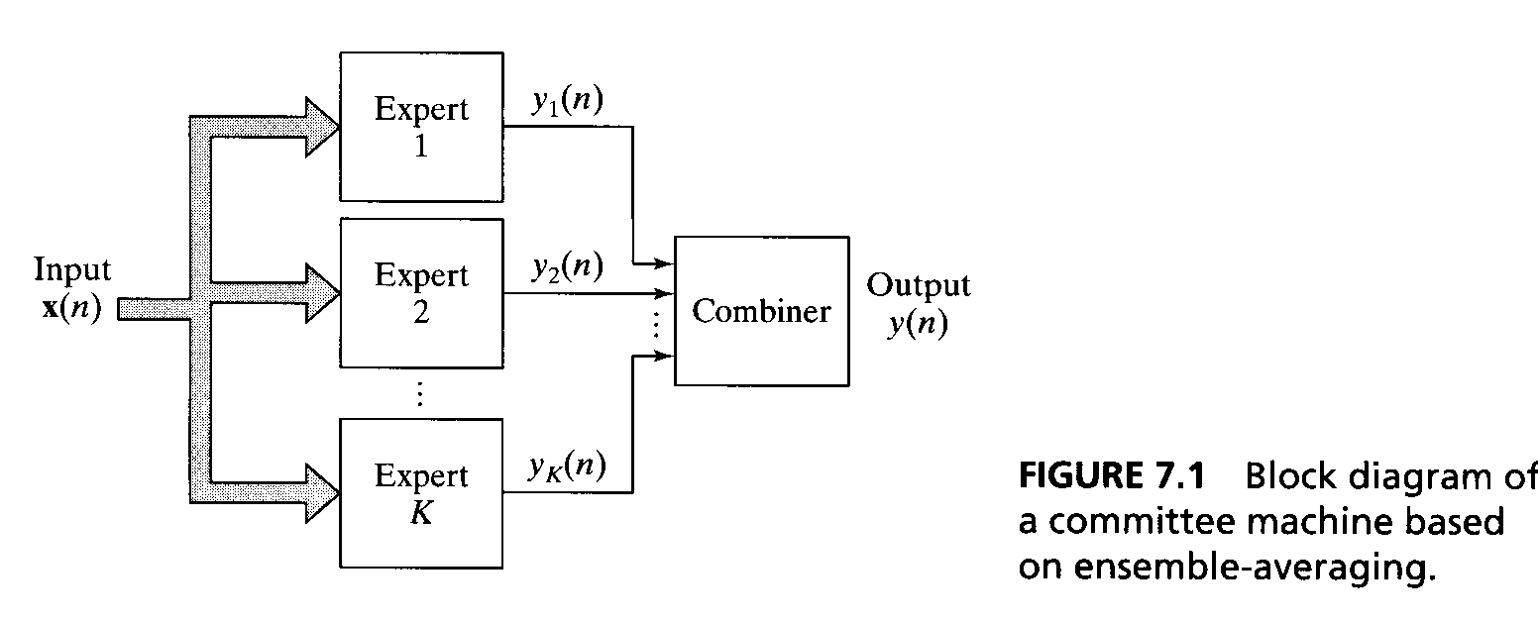
7.2Some Theory(Ensamble Averaging: )
Ensamble Averaging: A number of differently trained neural networks, which share a common input and whose individual outputs are somehow combines to produce an overall output.
Note, all the experts are trained on the same data set, they may differ from each other in the choice of initial conditions used in network training.
The output is sum of the individual outputs of the experts and then computing the probability of correct classification.

Slide 9
Some Theory
Two conclusion:
The bias of the ensemble-averaged function F_{I}(x), pertaining to the commitee machine is exactly the same as that of the function F(x) pertaining to a single neural network.
The variance of the ensemble-averaged function F_{I}(x) is less than that of the function F(x).

Slide 10
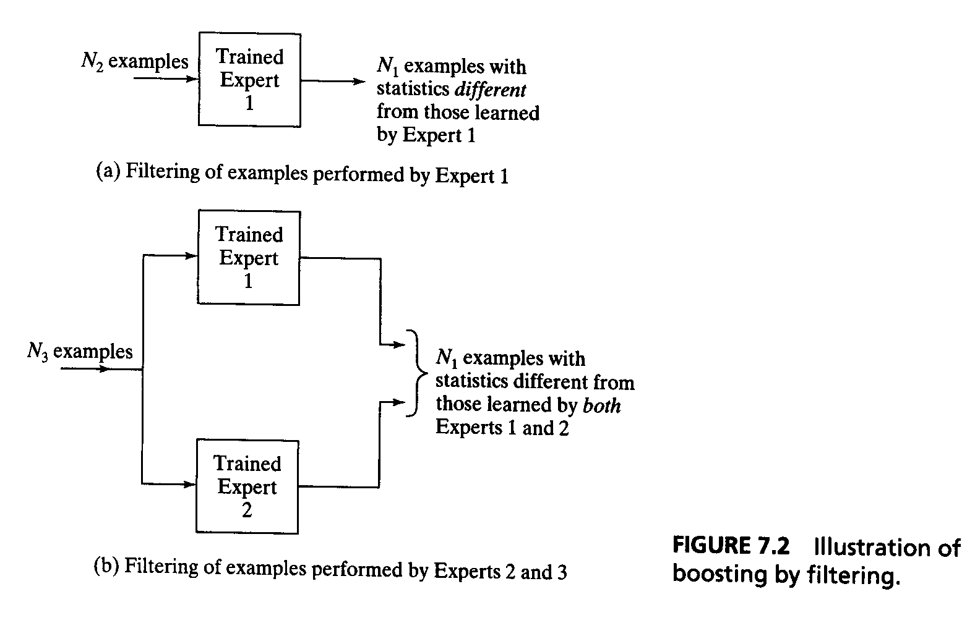
7.4Some Theory (Boosting: )
Boosting: the experts are trained on data sets with entirely different distributions.
Boosting by filtering
Boosting by subsampling
Boosting by reweighting

Slide 11
Some Theory
The original idea of boosting is rooted in a distribution-free or probably approximately correct model of learning (PAC).
Boosting by filtering: the committee machine consists of three experts (requires a large data set).
1. The first expert is trained on a set consisting of N₁ examples.

Slide 12
Some Theory
2. The trained first expert is used to filter another set of examples by proceeding in the following manner:
Flip a fair coin( ~ simulates a random guess).
1)If the result is heads, pass a new pattern through the first expert and discard correctly classified patterns until a pattern is missclassified. That missclassified pattern is added to the training set for the second expert.
2)If the result is tails, pass new patterns through the first expert and discard incorrectly classified patterns until apattern is classified correctly. That correctly classified pattern is added to the training set for the second expert.
3)Continue this process until a total of N₁ examples has been filtered by the first expert. This set of filtered examples constitutes the training set for the second expert.

Slide 13
Some Theory
3. Once the second expert has been trained in the usual way, a third training set is formed for the third expert by proceeding in the following manner:
1)Pass a new pattern through both the first and the second experts. If the two experts agree in their decisions, discard that pattern. If they disagree, the pattern is added to the training set for the third expert.
2)Continue with this process until total N₁ examples has been filtered jointly by the first and second experts. This set of jointly filtered examples constitutes the training set for the third expert.

Slide 14
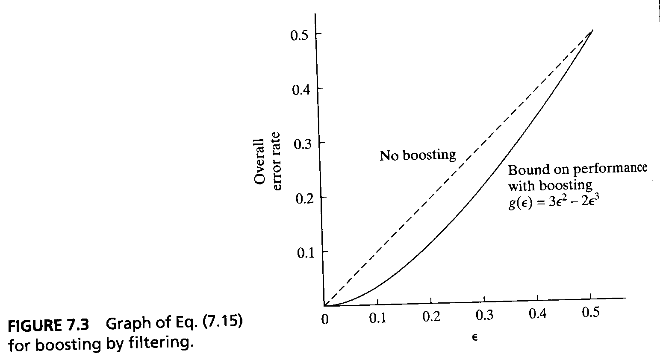
Some Theory
Classification: If the first and the second experts in the committee agree in their respective decisions, that class label is used. Otherwise, the class label discovered by the third expert is used.
The three experts have an error rate of ε < 1/2
g(ε) = 3ε² -2ε³

Slide 15
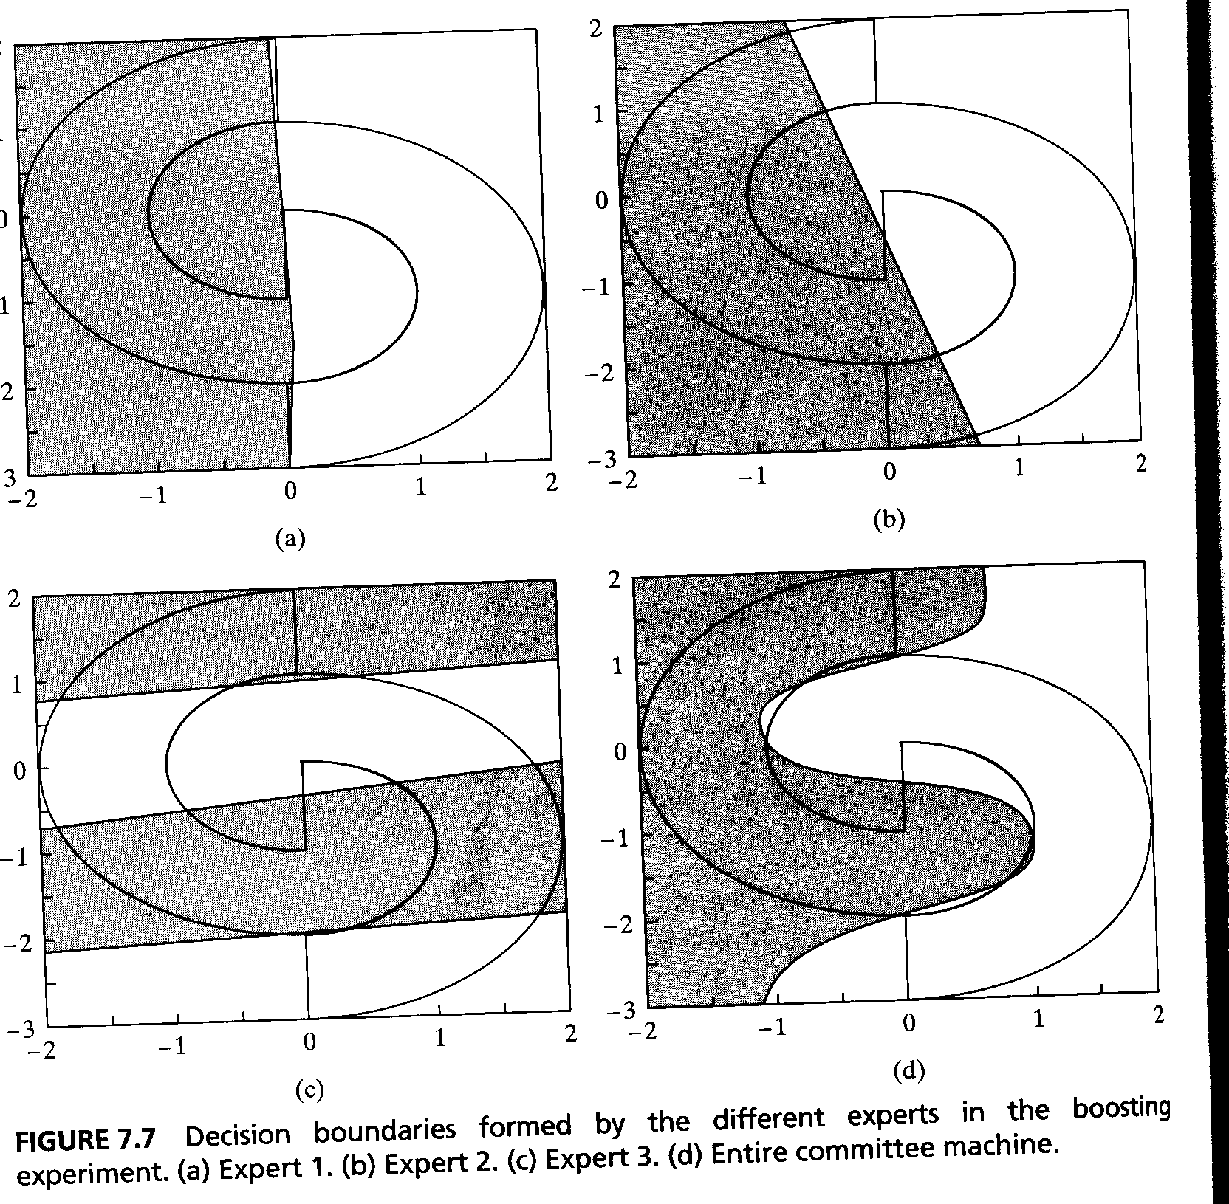
Some Theory

Slide 16
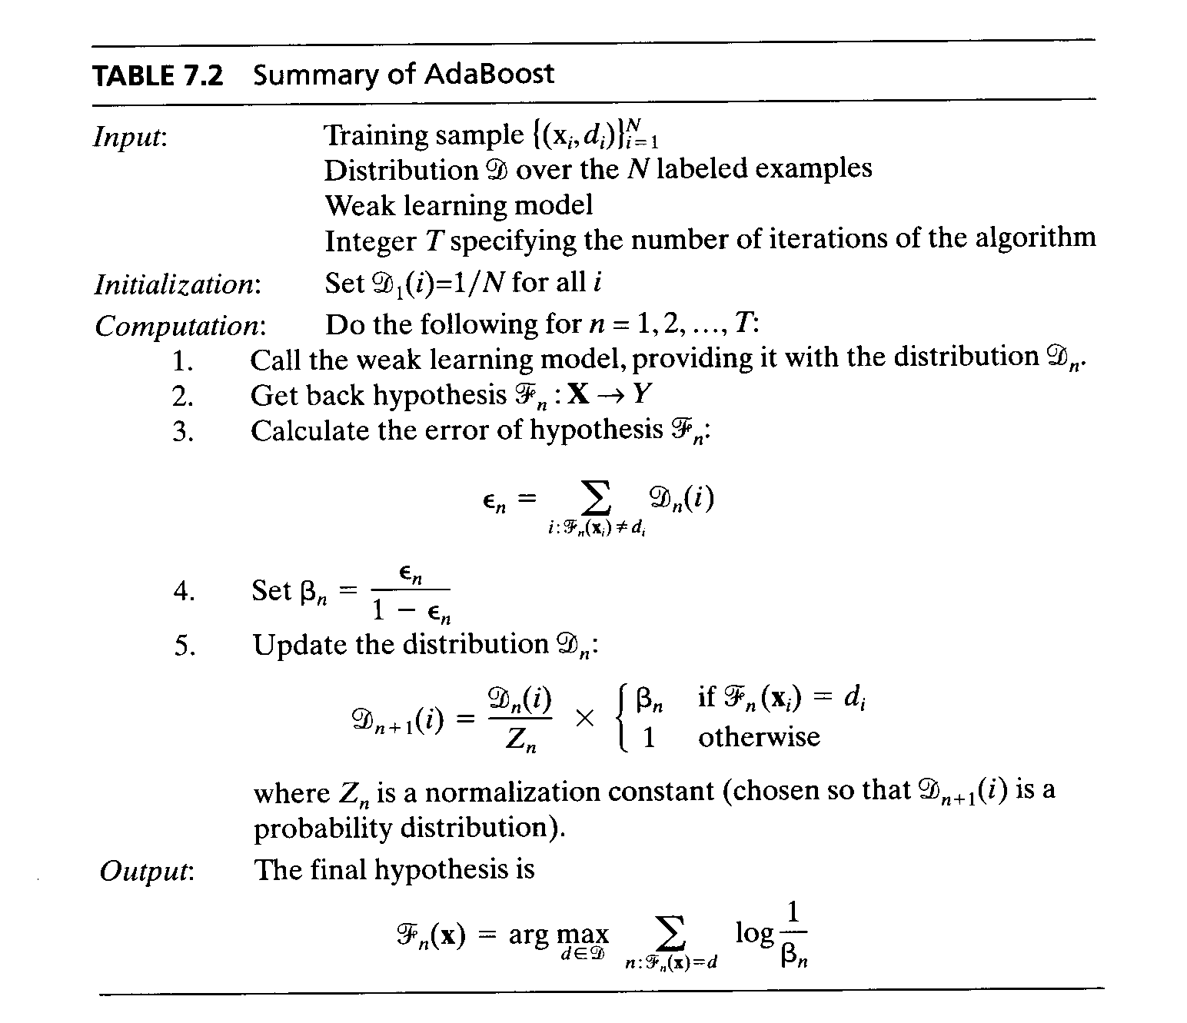
Some Theory
AdaBoost (boosting by resampling -> batch learning)
AdaBoost adjusts adaptively to the error of the weak hypothesis returned by the weak learning model.
When the number of possible classes (labels) is M>2, the boosting problem becomes more intricate.

Slide 17
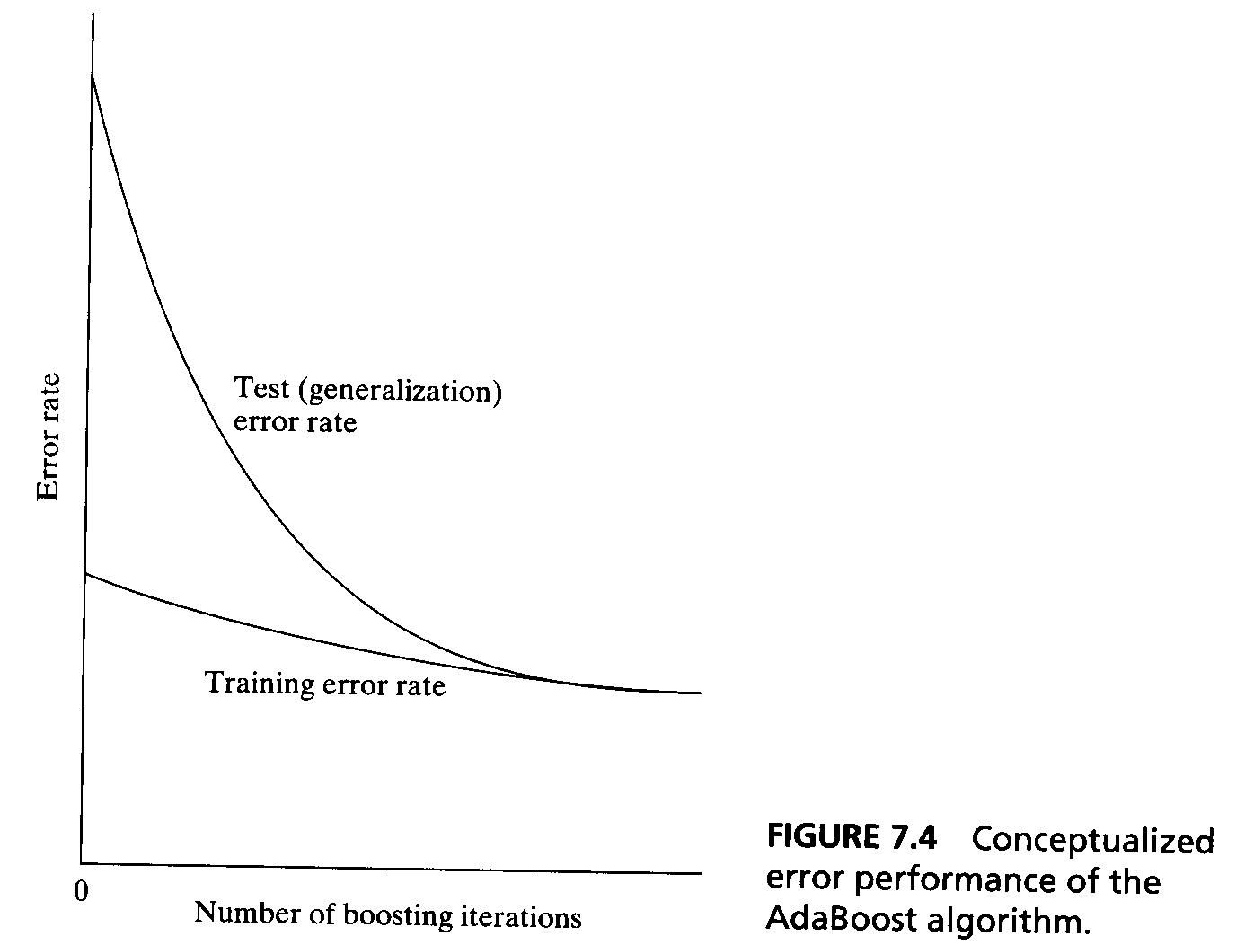
Some Theory
Error performance due to AdaBoost is peculiar.
The shape of the error rate debends on the definition of confidence.

Slide 18
7.6Some Theory(Probabilistic generative model)
Dynamic is used here in the sense that integration of knowledge acquired by the experts is accomplished under the action of the input signal.
Probabilistic generative model
1. An input vector x is picked at random from some prior distribution.
2. A perticular rule, say kth rule, is selected in accordance with the conditional probability P(k|x,a⁽⁰⁾), given x and some parameter vector a⁽⁰⁾.
3. for rule k, k<01,2,...,K, the model response d is linear in x, with an additive error ε_{k} modeled as a Gaussian distributed random variable with zero mean and unit variance:
E[ε_{k}] = 0 for all k and var[ε_{k}] = 1 for all k.
P(D=d|x,Θ⁽⁰⁾ ) = Σ^{K}_{k=1} P(D=d|x,w_{k}⁽⁰⁾ ) P(k|x,a⁽⁰⁾),

Slide 19
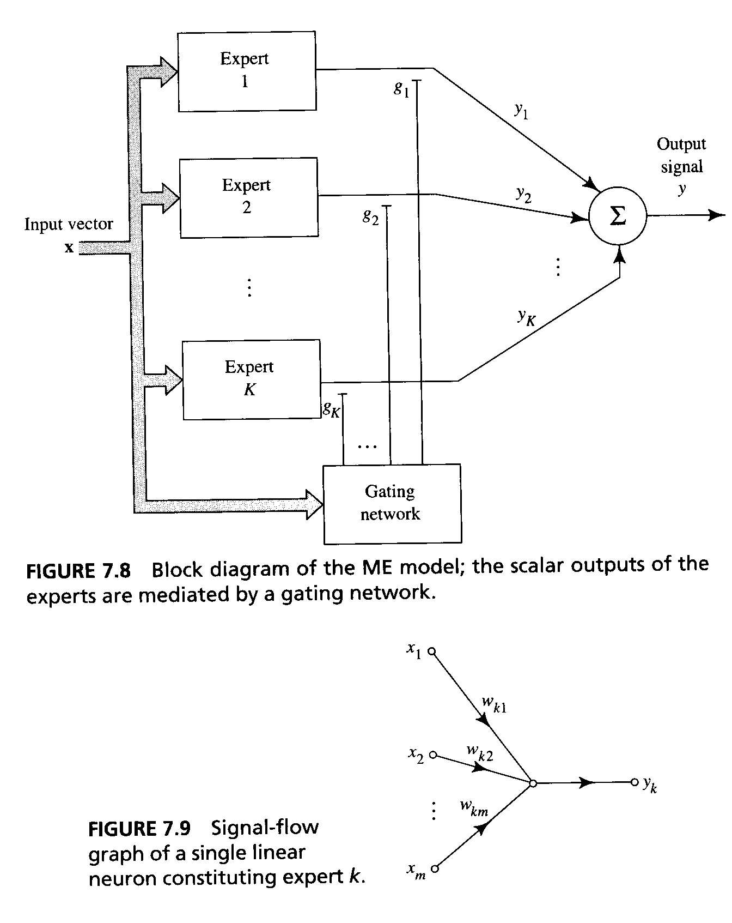
Some Theory
Mixture of Experts Model:
y_{k} = w_{k}^{T}x k=1,2,...,K
The gating network consists of a single layer of K neurons, with each neuron assigned to a specific expert.

Slide 20
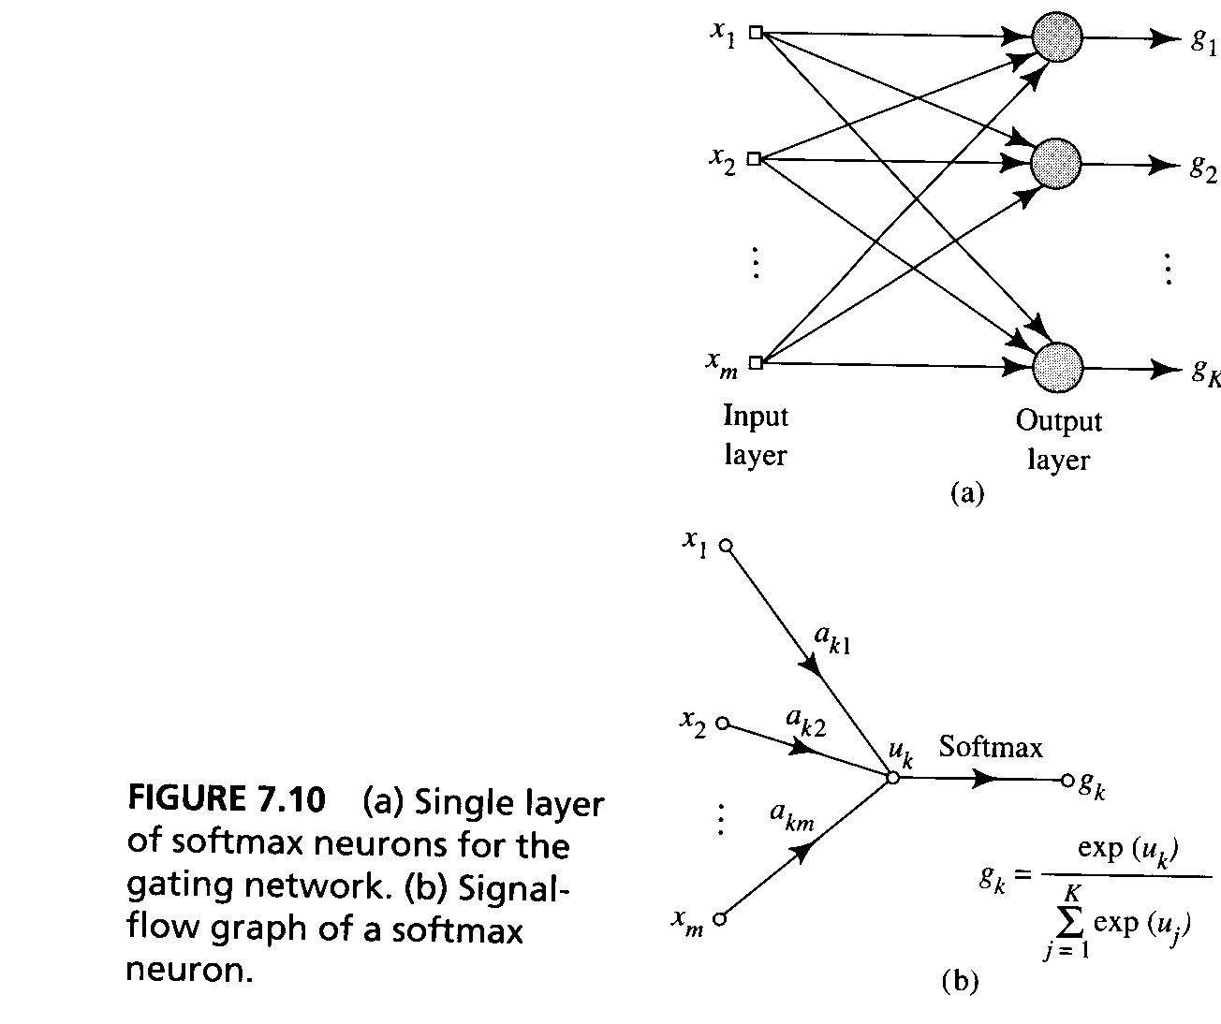
Some Theory
The neurons of the gating network are nonlinear.
g_{k} = exp(u_{k})/Σ^{K}_{j=1}exp(u_{j})
k = 1,2,...,K and u_{k} = a_{k}^{T}x -> Softmax
The gating network is a ”classifier” that maps the input x into multinomial probabilities -> The different experts will be able to match the desired response.

Slide 21
Some Theory
f_{D}(d|x,Θ) = Σ^{K}_{k=1} g_{k} f_{D}(d|x,k,Θ)
= 1/√2∏ Σ^{K}_{k=1} g_{k} exp(-1/2(d-y_{k})²)
associative Gaussian mixture model →
Given the training sample {(x_{i} ,d_{i})}^{N}_{i=1}, the problem is to learn the conditional means μ_{k} = y_{k} and the mixing parameters g_{k},k = 1,2,...,K in an optimum manner, so that f_{D}(d|x,Θ) provides a good estimate of the underlying probability density function of the environment responsible for generating the training data.

Slide 22
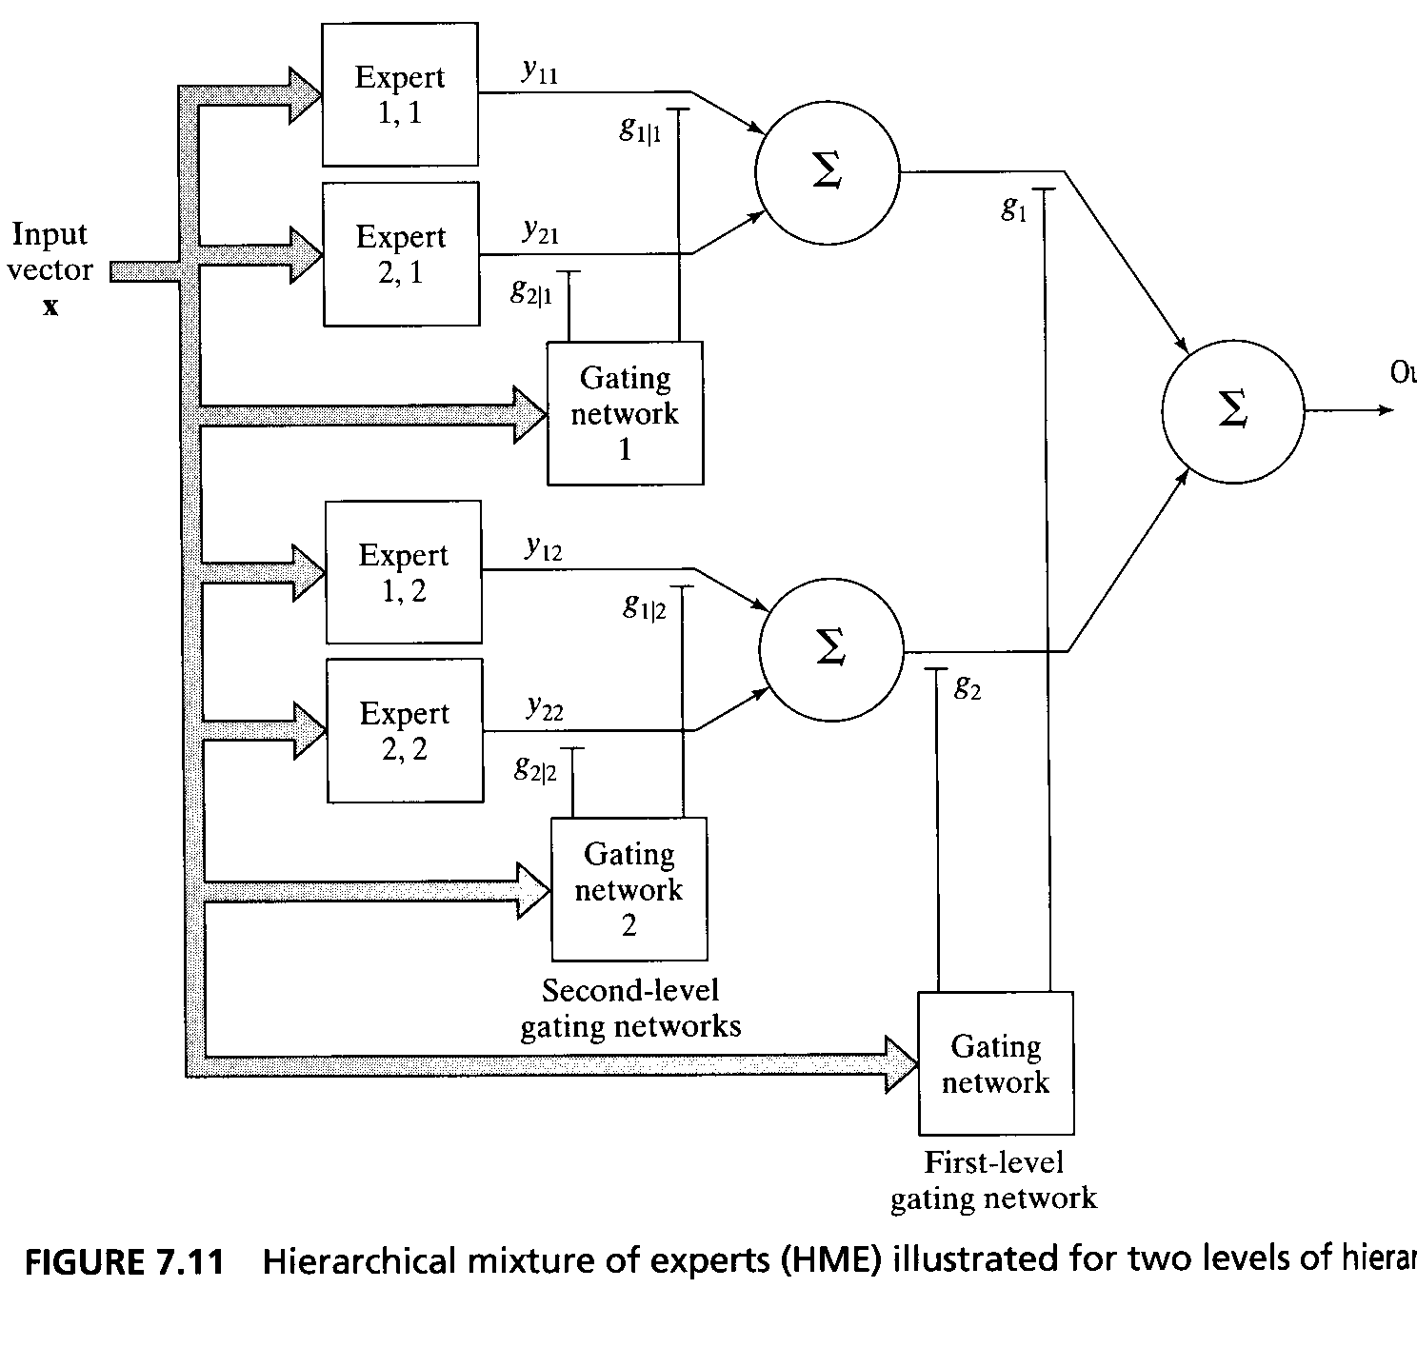
7.7Some Theory
Hierarchical Mixture of Experts Model
Hierarchical Mixture of Experts Model
HME is a natural extension of the ME model.
The HME model differs from the ME model in that the input space is divided into a nested set of subspaces, with the information combined and redistributed among the experts under the control of several gating networks arranged in a hierarchical manner.

Slide 23
Some Theory
The formulation of the HME model can be viewed in two ways.
1) The HME model is a product of the divide and conquer strategy
2) The HME model is a soft-decision tree
Standard decision trees suffer from a greediness problem, once a decision is made in such a tree, it is frozen and never changes thereafter.

Slide 24
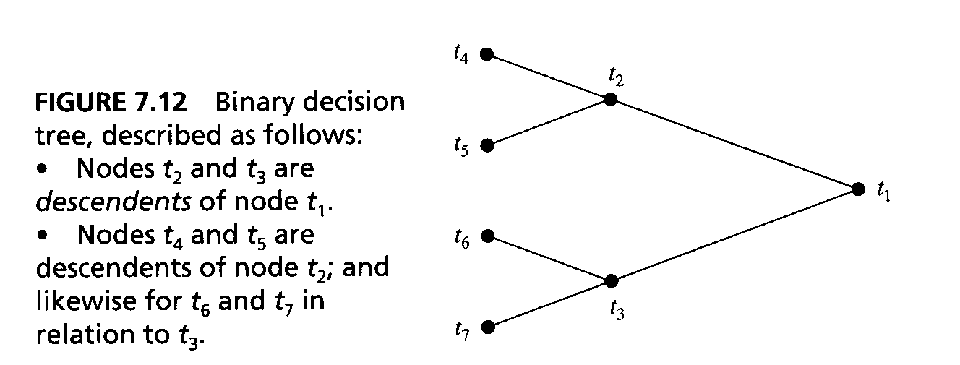
7.8Some Theory
Classification and decision tree
Classification and decision tree (CART Breiman 1984)
selection of splits: let a node t denotea subset of the current tree T. Let d⁻(t) denote the average of d_{i} for all cases (x,d_{i}) falling into t, that is, d⁻(t) = 1/N(t) Σ_{xj∈t} d_{i}
where the sum is over all d_{i} such that x_{i}∈t and N(t) is the total number of cases t.
Define E(t) = 1/N Σ_{xj∈t} (d_{i} – d⁻(t))² and E(T) = Σ_{t∈T} E(t)
The best split s* is then taken to be the particular split for which we have ∆E(s*,t) = max s_{∈S} ∆E(t,s)

Slide 25
7.8Some Theory
2)Determination of a terminal node: A node t is declared a terminal node if this condition is satisfied:
max s_{∈S} ∆E(s,t) < th, th is a prescribed threshold.
3)Least-square estimation of a terminal node’s parameters:
Let t denote a terminal node in the final binary tree T, and let X(t) denote the matrix composed of x_{i} ∈t. Let d(t) denote the corresponding vector composed of all the d_{i} in t. Define
w(t) = X⁺(t)d(t)
where X⁺(t) is the pseudoinverse of matrix X(t).
Using the weights calculated above , the split selection problem is solved by looking for the least sum of squared residuals with respect to the regression surface.

Slide 26
7.8Some Theory
g = 1 / {1+exp(-(a^{T}x +b))}
Using CART to initialize the HME model:
1) Apply CART to the training data
2) Set the synaptic weight vectors of the experts in the HME model equal to the least-squares estimates of the parameter vectors at the corresponding terminal nodes of the binary tree resulting from the application of CART.
3) For the gating networks:
a) set the synaptic weight vectors to point in direction that are orthogonal to the corresponding splits in the binary tree obtained from CART and
b) set the lengths of the synaptic weight vectors equal to small random vectors.

Slide 27
7.9Some Theory
A posteriori probabilities at the nonterminal nodes of the tree:
h_{k}= g_{k}Σ²_{j=1} g_{j|k} exp(-1/2(d-y_{jk})²) / {Σ²_{k=1} g_{k} Σ²_{j=1} g_{j|k} exp(-1/2(d-y_{jk})²)}
h_{j}|_{k}= g_{j|k} exp(-1/2(d-y_{jk})²) / { Σ²_{j=1} g_{j|k} exp(-1/2(d-y_{jk})²)}
the joint a posteriori probability that expert(j,k) produces an output y_{jk} :
h_{jk} = h_{k} h_{j}|_{k}
= g_{k} g_{j|k} exp(-1/2(d-y_{jk})²) / {Σ²_{k=1} g_{k} Σ²_{j=1} g_{j|k} exp(-1/2(d-y_{jk})²)}
0 ≤ h_{jk} ≤ 1 for all (j,k); Σ²_{j=1} Σ²_{k=1} h_{jk} = 1

Slide 28
7.10 Some Theory
The parameter estimation for the HME model:
Maximum likelihood estimation: y = Σ²_{k=1} g_{k} Σ²_{j=1} g_{j|k} y_{jk}
f_{D}(d|x,Θ) = 1/√2∏ Σ²_{k=1} g_{k} Σ²_{j=1} g_{j|k} exp(-1/2(d-y_{k})²)
likelihood function l(Θ)= f_{D}(d|x,Θ)
log-likelihood function L(Θ)= log[f_{D}(d|x,Θ)]
∂ L(Θ) / ∂ Θ = 0 → the maximum likelihood estimate

Slide 29
7.11Some Theory(Learning strategies for the HME model)
Learning strategies for the HME model
1. Stochastic gradient approach
This approach yields an on-line algorithm for the maximization of L(Θ).
∂ L / ∂ w_{jk} = h_{j|k}(n) h_{k} (n)(d(n) – y_{j|k}(n))x(n)
∂ L / ∂ a_{k} = (h_{k}(n) – g_{k}(n))x(n)
∂ L / ∂ a_{jk} = h_{k}(n)(h_{j|k}(n) – g_{j|k}(n))x(n)

Slide 30

7.12Some Theory
2. Expectation-maximization approach
Expectation step (E-step), which uses the observed data set of an incomplete data problem and the current value of the parameter vector to manufacture data so as to postulate an augmented or so-called complete data set.
Maximization step (M-step), which consists of deriving a new estimate of the parameter vector by maximizing the log-likelihood function of the complete data manufactured in the E-step.

Slide 31
Some Theory
The EM algorithm is directed at finding a value of Θ that maximizes the incomplete-data log-likelihood function L(Θ)= log[f_{D}(d|Θ)]
This problem is solved indirectly by working iteratively with the complete-data log-likelihood function L_{c}(Θ)= logf_{c}(r|Θ), which is a random variable, because the missing data vector z is unknown.
E-step: Q(Θ,Θ^(n)) = E[L_{c}(Θ)]
M-step maximize Q(Θ,Θ^(n)) with respect to n →
Θ^(n+1) = arg max _{Θ} Q(Θ,Θ^(n)); continue until the difference between L(Θ^(n+1)) and L(Θ^(n)) drops to some arbitrary small value

Slide 32
7.13Some Theory (EM in HME application
f_{D}(d_{i}|x_{i},Θ) = 1/√2∏ Σ²_{k=1} g^{(i)}_{k} Σ²_{j=1} g^{(i)}_{j|k} exp(-1/2(d_{i}-y^{(i)}_{k})²)
L(Θ)= log[∏^{N} _{i=1} f_{D}(d_{i}|x_{i},Θ)]
L_{c}(Θ)= log[∏^{N} _{i=1} f_{c}(d_{i},z^{(i)}_{jk}|x_{i},Θ)]
Q(Θ,Θ^(n)) = E[L_{c}(Θ)]
= Σ^{N}_{i=1} Σ²_{j=1} Σ²_{k=1} h^{(i)}_{jk} (log g^{(i)}_{k} + log g^{(i)}_{j|k} -1/2(d^{(i)} – y^{(i)}_{jk})² →
w_{jk}(n+1) = arg min_{wjk} Σ^{N}_{i=1} h^{(i)}_{jk} (d_{i} – y^{(i)}_{jk})²
a_{j}(n+1) = arg max_{aj} Σ^{N}_{i=1} Σ²_{k=1} h^{(i)}_{k} log g^{(i)}_{k}
a_{jk}(n+1) = arg max_{ajk} Σ^{N}_{i=1} Σ²_{l=1} h^{(i)}_{l} Σ²_{m=1} h^{(i)}_{m|l} log g^{(i)}_{m|l}

Slide 33
Summary
Ensemble averaging improves error performance by combining two effects: a) overfitting the individual experts b) using different initial conditions in the training of the individual experts
Boosting improves error performance by filtering and resampling .

Slide 34
Summary
Simple models provide insight into the problem but lack accuracy
Complex models provide accurate results but lack insight.
The architecture of HME is similar to that of CART, but differs from it in soft partitioning the input space.
The HME uses a nested form of nonlinearity similar to MLP, not for the purpose of input-output mapping, but rather for partitioning the input space.

